Slide 1

Introduction to:
Domain Driven Design
and
Hexagonal Architecture
(also known as Ports and adapters)
By Dragos Luca
Notes:
Eric Evans author of DDD

Slide 2
What is DDD ?
Domain-driven design (DDD) is an approach to software development for complex needs by connecting the implementation to an evolving model.
(Wikipedia: link )
My opinion: it is a way of building and delivering good quality software
Notes:
DDD provides a structure of practices and terminology for making design decisions that focus and accelerate software projects dealing with complicated domains.

Slide 3
Why should I do DDD ?
it’s main goal is to deal/manage with the business complexity
brings together domain experts and IT people ( from QA to DEV to Architects ) practically the whole business
the main “star” is the domain (a.k.a the business) knowledge
promotes collaboration and communication at all levels
creates a common understanding of what is required to be done (the ubiquitous language)
it is not a process ( like Scrum ) as it does not have “ceremonies”
Notes:
This is in very short terms the selling part
Using software to leverage the business strategy

Slide 4
When should be used and why it is not a silver bullet ?
When there is no business complexity:
like pure CRUD applications
where there is only technical complexity but not business complexity ( example: using the API of a graphic card to draw a circle)
Notes:
All this is not free and comes with a price: time
I want to be clear from the beginning that DDD is not applicable on all over the places
It is not considered a silver bullet that will fix anything

Slide 5
Let’s get our hands dirty ☺
Strategical design and Tactical design
The best way to talk and learn about DDD is through an example
For this presentation I’ve invited a special client:
Darth Vader the 3rd needs help in building a management system for the Death Star ship production and storage of energy and ammo.
Notes:
We are focusing only on a small part of the business domain for presentation purposes
And also this part is highly diluted as the time to present is very short

Slide 6


Why ubiquitous language is important ?
Notes:
Having a common understanding is very important in delivering the right software
It is saying that a picture is worth 1000 words

Slide 7
Ubiquitous language
should be the same language spoke by developer and domain experts to avoid miscommunication, delays and errors
is not a static and it should evolve once the domain is being explored and understood
reflect the language in code how users of the software think and speak about their work
once a discrepancy is found this constitute the invitation to dialog and clear it out
users of the ubiquitous language: everybody in the same project

Slide 8
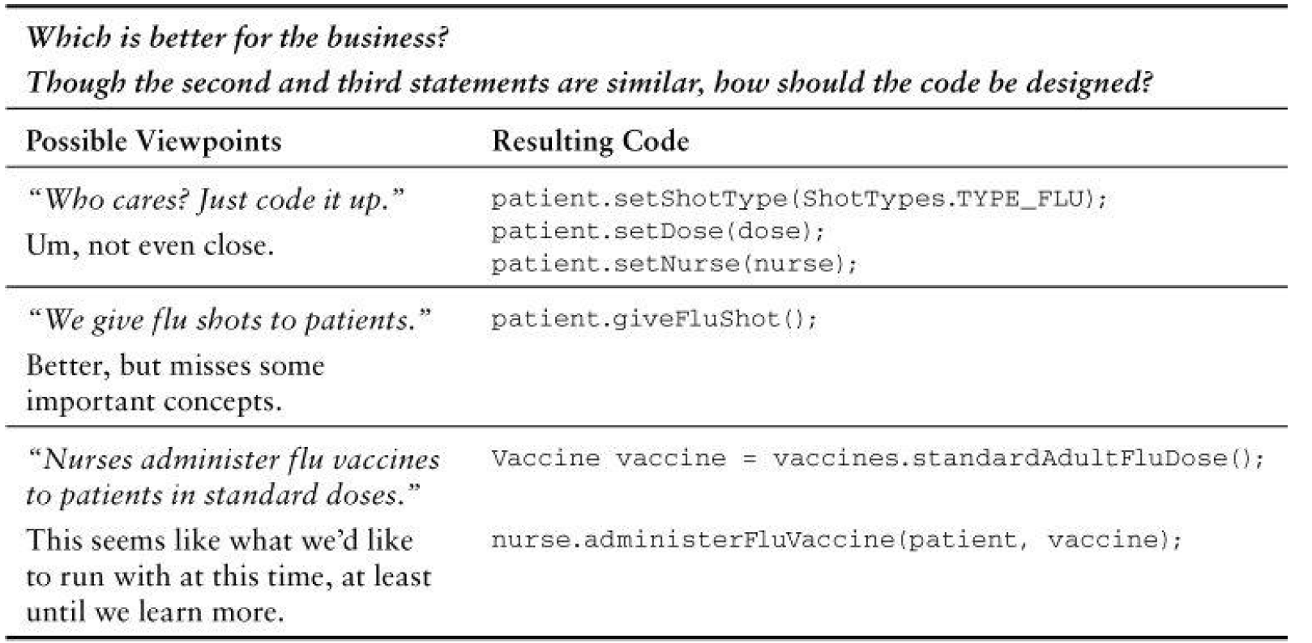
Example:
Notes:
This example is found in the Vaughn Vernon book
Writing code good, clean and meaningful code has 2 very important positive aspects:
It is easy to maintain in time as the developer ( the human ) who reads the code will know quickly where to make the changes. This is translating in fast changes and money for the company
For a new developer getting up to speed

Slide 9
Subdomains, bounded context and context maps
Strategical design
the entire business of Death Star is considered the business domain
we are dealing with only a part of it, a subdomain
a Bounded Context is not a Module. A Bounded Context provides the logical frame inside of which the model evolves. Without the Bounded Context we loose the meaning and all things start to get confuse
In most cases the bounded context overlaps with the subdomain
Notes:
we do not try so solve all the problems are once because of the complexity
For example a user can have different meaning in different contexts
Core domain, support domain and generic domain

Slide 10
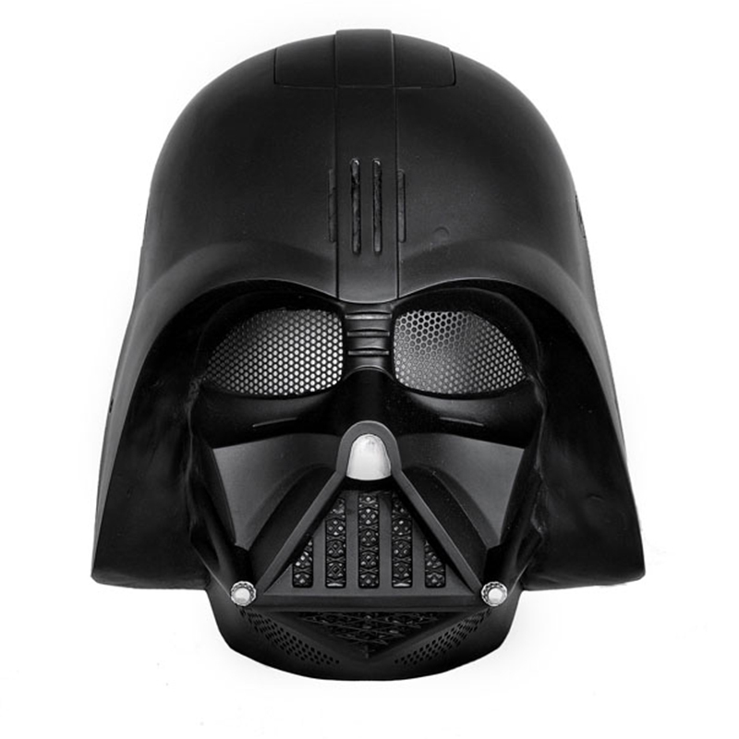
Building domain knowledge and defining parts of the ubiquitous language
Strategical design
Me: We want to help you build your death start management system how do we start ?
: Thinking of the basics the heart of the Death Star are his factories of ammunition and energy.
Me: And what are the outputs of those factories and what do you do with them?
: We produce ammunition of type A and B and energy of course.
Should you see how beautiful those type B explodes. They are my favourites. Then we are using the transport system to move them to the storage areas
Me: How the factories work ?
: Based on current needs I sent orders to the factories to produce
Me: Got it. Like a production strategy …
Notes:
Darth Vader is the domain expert and our client
This a sample from the conversation with our client to build the ubiquitous language
Focus on the essentials and try to define the core
This Darth Vader is quite a chatty guy when he starts talking about Death Star

Slide 11
Strategical design
Resume of the talk with our domain expert ( Darth Vader )
Energy level reactor produces energy to power the Death Star and it's facilities. It's production as in real life is bound by time. Only a certain amount of energy can be produced in a unit of time (ex: 1 unit per second). Local storage capacity is of 20 units.
The internal transport has a capacity of 6 units per second. Also it takes the resources and distributes them as required based on current priorities. The priorities can be either EnergyProducing, AmmunitionLoad or BalancedEnergyAmmunition
The ammunition factory uses 1 unit of energy per ammunition type. And again based on Ammunition Priority it can produce Ammo type A, Ammo type B or both.
The access to the system is provided by an existing system called FAR (Force Fingerpring Recognition). ( This is a good example how we interact with existing systems)
During "public holidays" the system can be shut down and then powered it again.
Also each system has a safety mechanism of hibernation: meaning the activity is stopping when the storage levels are full

Slide 12
Bounded context and context maps
Strategical design
Force Fingerprint
System
Ammunition Factory
Energy Factory
Ammunition
Energy Local Storage
Ammunition Type A
Energy
Ammunition Type B
Factory strategy
Navigation
Transport system
Central Storage
Many other more
Bounded contexts
Notes:
Notice that at this moment we didn’t talk at all about technologies, architecture and that not a single line of code was written.
There is no rule related to the size of a bounded context
The communication between bounded context can be done through multiple methods like messaging, REST
It builds on a basic software principle: low coupling and high cohesion

Slide 13
Even if we are not doing DDD we can still take some good things:
Promotes communication: discuss or talk or chat about the domain
Focus on learning better the business knowledge of the project
Clarify the uncertainties by defining a well understood meaning for all parties involved ( role of the ubiquitous language )
Notes:
-although we mostly are already doing this is still worth mentioning them

Slide 14
Tactical design
“Building blocks” of DDD
Value Objects
Entities
Aggregates and Aggregate root
Domain Services
Repositories
Purist of DDD: inside the domain there is no automatic dependency injection (Spring context and Google Guice are banned :P ). The DI is controlled from constructors and when needed through method DI
Note: automatic DI is used inside DDD applications but not in the domain. Above the domain layer ( in application or infrastructure ) is recommend to use automatic DI.
Notes:
Constructor DI: when you create the object at that moment you provide all dependency requirement
Method DI: is more like I give you all the stuff to perform the operation

Slide 15
Value objects
Tactical design
They do not have identity ( no unique id )
They should be “thin” and simple
Which means that they are easy to create and discard
Highly recommended to be immutable
Is good to override equals and hashcode methods
Any business logic which is contained in a value object can not modify the state of it

Slide 16
Example of value object
Tactical design
@Immutable
class Ammunition {
final private static double area = 1
final private AmmunitionType ammunitionType
final private double power
public double calculateExplosiveArea() {
return area * power
}
}
Notes:
- Simplified version of the class as it is not containing the whole content
- We do not need to have the identity of a bullet
They can have business logic but because they are immutable the contained business logic will not change the object state

Slide 17
Entities
Tactical design
the highlight of the object is his identity
the identity is not changing throughout states of object
the business logic can change the object state
Notes:
- The identity in itself is a complex topic ( from the simplest form like an number to a more complex like an UUID and then more complex like a group of attributes which uniquely identify the entity )

Slide 18
Example of an entity object
Tactical design
class EnergyFactory {
UUID uuid
String name
Storage<Energy> factoryStorage
EnergyFactory(UUID uuid) {
this.uuid = uuid
}
public produceEnergy( ) {
//more complex logic can be added to produce energy based on a timer
factoryStorage.add(new Energy())
}
public Optional<Energy> takeEnergyItem() {
factoryStorage.takeOne()
}
public List<Energy> depleteFactoryStorage() {
factoryStorage.depleteStorage()
}
}
Notes:
- The class can be read from left to right

Slide 19
Aggregates and aggregates root ( part 1 )
Tactical design
an aggregate is no more then an entity which contains other entities and/or value objects ( a group of objects )
it has identity
the whole aggregate is seen as one
due to his nature (seen as one unit) it is also providing boundaries
it can hold references to other aggregates
if there are other Entities inside the boundary, the identity of those entities is local, making sense only inside the aggregate.
Notes:
- The boundaries are created because for an outside object it can only see the aggregate and can work with only the operations provided by it. The outside object will not have any reference of an object contained in the aggregate

Slide 20
Aggregates and aggregates root ( part 2 )
Tactical design
usually at the aggregate actions represent the transaction demarcations
the aggregate is persisted as one through an repository
the aggregate which is persisted we call it the aggregate root
an aggregate can have references to other aggregates but they are not part of the aggregate
Notes:
- For my example as is not very complex we can consider the factories as an aggregate root

Slide 21
Domain services
Tactical design
usually they hold any other business logic which can not be places inside an entity or a value object
they are stateless
they can be seen as coordinators for high level functions which involve the aggregates and/or the entities

Slide 22
Example of domain service
Tactical design
class TransportSystem {
public transferResources(def source, def destination) {
// take resources from source
// and move them to destination based on a map/route/load strategy etc
}
}
Notes:
the most simple example I could find related to a domain service
This logic naturally does not make sense to be contained in any of the other domain objects like a factory or the warehouse

Slide 23
Repositories ( part 1 )
Tactical design
is the gateway to persistence of the aggregate roots
in the domain they are only provided as an interface but the whole implementation is on another layer
his role is to mediate between domain objects and their persistent form
the repository knows intimate details on how an aggregate root is persistent
in the repository we can make decision to save the aggregate root in normalized db or in a denormalized form

Slide 24
Repositories ( part 2 )
Tactical design
we can swap quickly the persistence storage by providing a different implementation of the repository interface and thus protecting the domain of any storage decision
under the repository Assemblers can be used to transform the domain object into a persistence form which is then serialized
we do want to leak the domain object into the persistence layer and be changed by persistence needs
Notes:
- Not shown an example of the

Slide 25
Tactical design
Example of repository interface
interface EnergyFactoryRepository {
void saveFactory(EnergyFactory energyFactory)
EnergyFactory getFactory(String name)
EnergyFactory getFactory(UUID uuid)
}

Slide 26
More advanced topics
Just to mention them:
Event sourcing ( architectural pattern using domain events )
CQRS ( Command Query Responsibility Segregation )
Eventual consistency ( in distributed systems eventually everything will be consistent which is very different then ACID tranzactionality)
Notes:
Event Sourcing: An architectural pattern which warrants that your entities (as per Eric Evans’ definition) do not track their internal state by means of direct serialization or O/R mapping, but by means of reading and committing events to an event store. (from Wikipedia)

Slide 27
Even if we are not doing DDD we can still take some good things:
isolate better the business logic in our software
give meaningful method names to methods ( preferably from our domain )
test your business logic ( make sure those business invariants (a.k.a rules ) are respected and not changed )
use immutable objects where possible
Notes:
- Just to raise awareness on the points which are general valid

Slide 28
Hexagonal architecture (Ports and adapters)
Problems it tries to solve:
the business logic being entangled with infrastructure logic
increased maintainability as it keeps the concerns separate
adding flexibility
ease of testing
Note: http://alistair.cockburn.us/Hexagonal+architecture
Notes:
Hexagonal is used as a catchy name but there is no connection with the geometrical form
changing the persistence or adding a new type of communication should not change the business logic
We can easy provides mocks for any repository or other communication part

Slide 29
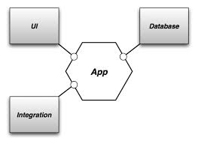
High level view
Hexagonal architecture
Note: image from from Victor Savkin blog link
Notes:
From a very high level we can see that everything is sealed ( one container )
This is how the application should look for the it’s dependencies
we can see the interaction with the outside

Slide 30
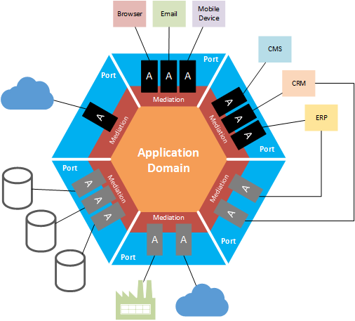
Hexagonal architecture
Low level view of the hexagonal
The layers:
Domain
Application
Infrastructure
Notes:
Specialized parts of the infrastructure are called ports
Ports for In and Out operation

Slide 31
Application layer
Hexagonal architecture
It has non functional responsibilities like:
provides the high level API of the application
security ( authorization )
tranzactionality

Slide 32
Anatomy of a application service:
Hexagonal architecture
uses the repository and aggregate factories to get an aggregate root
uses the aggregate root API ( public methods ) to perform an action
saves the aggregate root after his state has changed
the application service is stateless
don’t confuse it with the domain service

Slide 33
class ProductionApplicationService {
@Autowired
EnergyFactoryRepository energyFactoryRepository
public produceEnergy() {
//complex authorization here
EnergyFactory energyFactory = energyFactoryRepository.getFactory("EnergyFactory_01")
energyFactory.produce()
energyFactoryRepository.saveFactory(energyFactory)
}
}

Slide 34
Infrastructure layer
Hexagonal architecture
On this layer resides the low level implementation of the infrastructure like:
communication: calling an http client, calling an JMS producer
using the client of a of a cache layer
persistence: a wrapper of a persistence driver
Notes:
- Although the caches can reside on any level, it make sense to have the client of the cache in the infrastructure

Slide 35
Sources
Domain-driven Design: Tackling Complexity in the Heart of Software ( Eric Evans, author of DDD )
Implementing Domain-Driven Desing ( Vaughn Vernon )
Domain Driven Desing Quickly ( Abel Avram and Floyd Marinescu )
Hexagonal Architecture ( Alistair Cockburn )
Various blogs of DDD ( Google ☺ )
Sample classes can be found at my public repo link
Notes:
- Warning: watch what you put in the git repo. Do not put company confidential private info, do not put any keys to any sort. Git repos are scanned and I’ve seen some bad things

Slide 36
Thank you !

Slide 37

And may the force be with you !
Note: this picture is so funny I could not resist
not to add it to the presentation

